Slide 1
North molton

Slide 2
Paul McGuire – Head of Technical & Engineering
Ben Rowntree – Land Manager
Chris Greenslade– Senior Site Manager
Notes:
Introductions

Slide 3
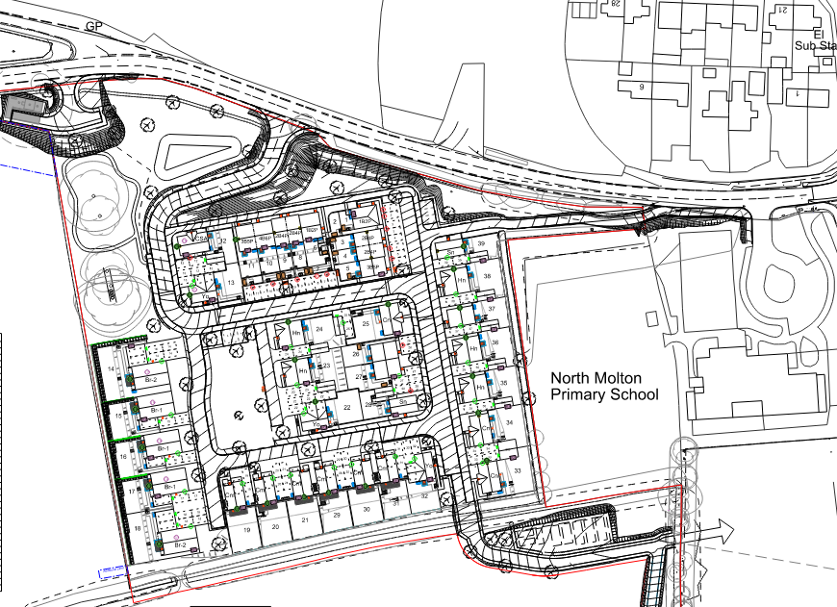
Scheme Overview (onsite)
Notes:
Development of 39 dwellings of which 11 are affordable housing.
Infrastructure works include, adopted carriageways & drainage
Drainage Pump station & attenuation basin
Public open space including equipped play area and land earmarked for allotments.
Works to date:
Access is formed (including large extent of cut into the land)
Entrance retaining walls are being formed
And vast bulk of highway is under construction
We have also started the substructure of the first few dwellings to the west.

Slide 4
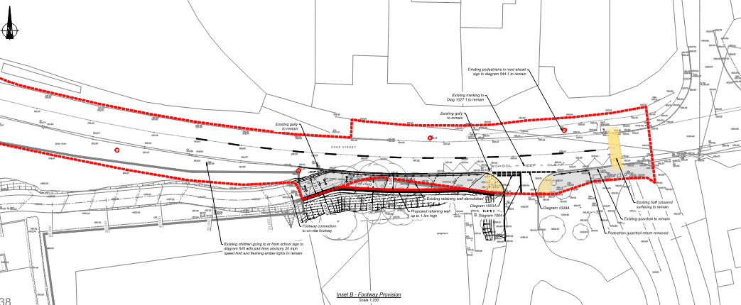
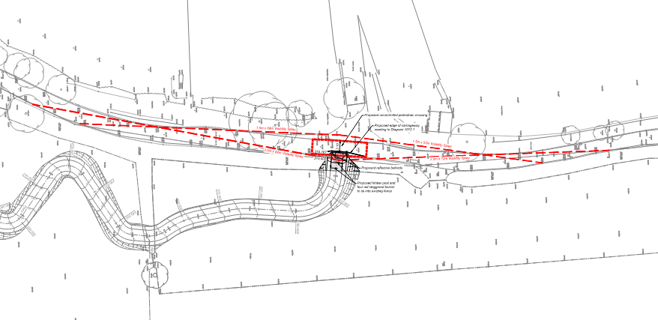
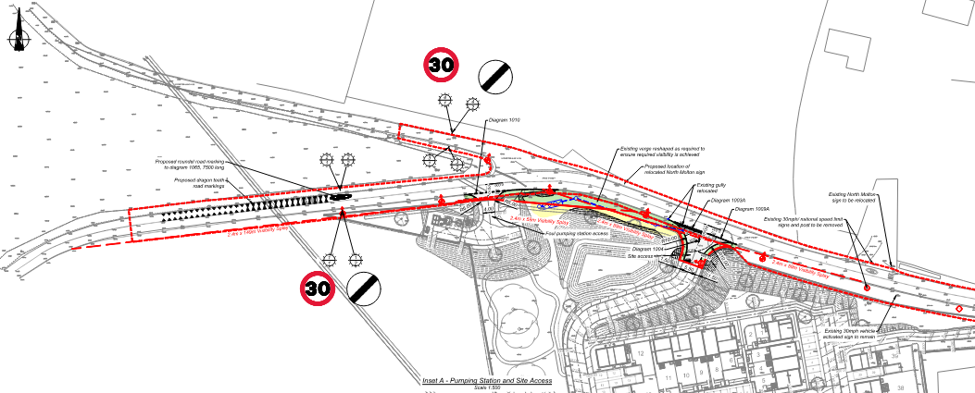
Scheme Overview (offsite)
Notes:
The offsite works are split into a few sections
This first section shows the entrance to the development including pump station entrance, additional signage, road markings & streetlighting to this area.
Secondly there is a footpath connection to the sports centre to the south of the site. I understand some concerns have been raised about the extent of the ‘build out’ in the area and the difficulty in manovuring vehicles in and out of the sports centre. I’m pleased to say a positive meeting was held this week with ourselves, the principle contractor, Devon Highways, Design Engineer and Counciller Liz Bulled and it looks like we have a solution to appease all stakeholders.
And lastly the most logistically complex section is outside the school whereby we are constructing a new retaining wall at the school entrance in order to facilitate safe footpath access to our development as well as installing a new water main to connect into the existing supply at Oakford Villas

Slide 5
Difficulties/Failings encountered…
Offsite Retaining Wall – Hit Rock
Water Main Connection – Highways enforcement:
Temporary lights failed over a weekend
Principle contractor failed to install appropriate signage showing emergency contact details
Devon County Council highways were called
Highways Officer covering the area due to absences deemed the works non-compliant and closed the road with emergency diversion.
Notes:
Offsite Retaining wall – Hit rock which meant we couldn’t finish the footpath/entrance works before the start of school term.
Failings occurred during the Water Main Connection –
Temporary lights failed over a weekend
Principle contractor failed to install appropriate signage showing emergency contact details
Devon County highways were called
Highways officer deemed the works non-compliant. This was extremely frustrating for us as well as yourselves and we apologise for this.

Slide 6
Next steps…
Now to Oct Half Term: minor works with traffic light system
Oct half Term – Completion of school retaining wall works and water mains laying
Early November – Water main connection (1m trench) and streetlight connections.
We will commit to meeting the Parish Council before October half term to ensure all measures are in place, resulting in as little disruption as possible to residents.

Slide 7
Current Programme…
Completion of School entrance works – October Half Term
Completion of all major offsite works to Fore Street – October Half Term
Water Main Connection – Early November
First occupations – Spring/Summer 2025
Payment of S106 obligations – Circa 111k is imminent with a further 11k at 10% Occupation and 100k at 50% Occupation
As Cavanna Homes become Principle Contractor we will be engaging with the school on education initiatives.

Slide 8
Any Questions…?

